Slide 1
CSE 326: Data Structures:
Graphs
Lecture 19: Monday, Feb 24, 2003

Slide 2
Today
A short detour into compression
  Since you liked the homework...
Single-source shortest path:
  Dijkstra’s algorithm
Minimum spanning tree:
  Kruskal’s algorithm
  Prim’s algorithm
All pairs shortest path:
  Floyd-Warshall’s algorithm
READ THE BOOK, CHAPTER 9 !!!

Slide 3
Detour: Compression
The ideal compressor:
  Input: any text T
  Output: T’ with length(T’) < length(T)
  Decompressor: given T’, compute T
There is no ideal compressor
  Why ???
What a compressor can achieve:
  If T has high probability, then length(T’) << length(T)
  If T has low probability, then length(T’) > length(T)

Slide 4
Detour: Compression
Huffman Coding (your homework):
A symbol-by-symbol compressor
Provably optimal if the probabilities all symbols are independent
In practice this is not true:
  ‘and’ is a very likely word: hence the probability of ‘d’ occurring after ‘an’ is much higher than the probability of ‘d’ occurring anywhere

Slide 5
Detour: Compression
Dictionary compressors:
T= | a | b | a | c | a | b | d | a | b | d | f | a | b | a | c
T’= | a | b | a | c | 3,2 | d | 2,3 | f | 10,4
length
offset

Slide 6
Detour: Compression
An extreme case:
How does this work ?
T= | a | a | a | a | a | a | a | a | a | a | a | a | a | a | a
gzip:
dictionary compressor
32Kbyte long sliding dictionary
258 bytes look-ahead buffer
separate Huffman codes for
characters, offsets, lengths
T’= | a | 0,14

Slide 7
Single Source, Shortest Path for Weighted Graphs
Given a graph G = (V, E) with edge costs c(e), and a vertex s ∈ V, find the shortest (lowest cost) path from s to every vertex in V
Graph may be directed or undirected
Graph may or may not contain cycles
Weights may be all positive or not
What is the problem if graph contains cycles whose total cost is negative?
Notes:
The problem that Dijkstra’s algorithm addresses is the single source, shortest path problem.
Given a graph and a source vertex, find the shortest path from the source to every vertex.
We can put a variety of limitations or spins on the problem.
We’ll focus on weighted graphs with no negative weights.
This is used in all sorts of optimization problems: minimum delay in a network, minimum cost flights for airplane routes, etc.

Slide 8
The Trouble with
Negative Weighted Cycles
2
A
B
10
-5
1
E
2
C
D
Notes:
You might wonder why we don’t allow negative weights. Here’s one reason, we’ll see another later.
The shortest path here is undefined! We can always go once more around the cycle and get a lower cost path.

Slide 9
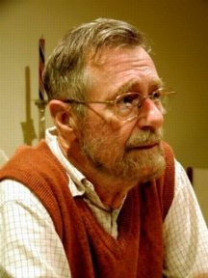
Edsger Wybe Dijkstra
(1930-2002)
Invented concepts of structured programming, synchronization, weakest precondition, and "semaphores" for controlling computer processes. The Oxford English Dictionary cites his use of the words "vector" and "stack" in a computing context.
Believed programming should be taught without computers
1972 Turing Award
“In their capacity as a tool, computers will be but a ripple on the surface of our culture. In their capacity as intellectual challenge, they are without precedent in the cultural history of mankind.”
Notes:
To move to weighted graphs, we appeal to the mighty power of Dijkstra.
This is one of those names in computer science you should just know! Like Turing or Knuth.
So, here’s the super-brief bio of Dijkstra.
Look him up if you’re interested in more.

Slide 10
Dijkstra’s Algorithm for
Single Source Shortest Path
Classic algorithm for solving shortest path in weighted graphs (with only positive edge weights)
Similar to breadth-first search, but uses a priority queue instead of a FIFO queue:
  Always select (expand) the vertex that has a lowest-cost path to the start vertex
  a kind of “greedy” algorithm
Correctly handles the case where the lowest-cost (shortest) path to a vertex is not the one with fewest edges
Notes:
Among the wide variety of things he has done, he created Dijkstra’s algorithm more than 30 years ago.
Dijkstra’s algorithm is a greedy algorithm (like Huffman encoding), so it just makes the best local choice at each step.
The choice it makes is which shortest path to declare known next.
It starts by declaring the start node known to have a shortest path of length 0. Then, it updates neighboring node’s path costs according to the start node’s cost.
Then, it just keeps picking the next shortest path and fixing that one until it has all the vertices.

Slide 11
void BFS(Node startNode) {
Queue s = new Queue;
for v in Nodes do
v.visited = false;
startNode.dist = 0;
s.enqueue(startNode);
while (!s.empty()) {
  x = s.dequeue();
  for y in x.children() do
  if (x.dist+1<y.dist) {
  y.dist = x.dist+1;
  s.enqueue(y);
  }
  }
}
void shortestPath(Node startNode) {
Heap s = new Heap;
for v in Nodes do
v.dist = ∝;
s.insert(v);
startNode.dist = 0;
s.decreaseKey(startNode);
startNode.previous = null;
while (!s.empty()) {
  x = s.deleteMin();
  for y in x.children() do
  if (x.dist+c(x,y) < y.dist) {
  y.dist = x.dist+c(x,y);
  s.decreaseKey(y);
  y.previous = x;
  }
  }
}

Slide 12
Dijkstra’s Algorithm:
Correctness Proof
Let Known be the set of nodes that were extracted from the heap (through deleteMin)
For every node x, x.dist = the cost of the shortest path from startNode to x going only through nodes in Known
In particular, if x in Known then x.dist = the shortest path cost
Once a node x is in Known, it will never be reinserted into the heap

Slide 13
Dijkstra’s Algorithm:
Correctness Proof
x.dist
startNode
Known

Slide 14
Dijkstra’s Algorithm in Action
2
2
B
3
A
F
H
1
1
2
4
10
1
9
4
G
2
C
8
D
1
E
7
Notes:
OK, let’s do this a bit more carefully.

Slide 15
Dijkstra’s Algorithm in Action
9
∝
∝
2
2
B
3
A
F
H
1
∝
1
2
4
10
1
9
0
4
G
2
C
8
∝
∝
D
1
E
7
8
next
Notes:
OK, let’s do this a bit more carefully.

Slide 16
Dijkstra’s Algorithm in Action
9
∝
∝
next
2
2
B
3
A
F
H
1
∝
1
2
4
10
1
9
0
4
G
2
C
8
9
15
D
1
E
7
8
Notes:
OK, let’s do this a bit more carefully.

Slide 17
Dijkstra’s Algorithm in Action
9
11
∝
2
2
B
3
A
F
H
1
∝
1
2
4
10
1
9
0
4
G
2
C
8
9
13
D
1
E
7
8
next
Notes:
OK, let’s do this a bit more carefully.

Slide 18
Dijkstra’s Algorithm in Action
next
9
11
11
2
2
B
3
A
F
H
1
∝
1
2
4
10
1
9
0
4
G
2
C
8
9
13
D
1
E
7
8
Notes:
OK, let’s do this a bit more carefully.

Slide 19
Dijkstra’s Algorithm in Action
9
11
11
next
2
2
B
3
A
F
H
1
∝
1
2
4
10
1
9
0
4
G
2
C
8
9
13
D
1
E
7
8
Notes:
OK, let’s do this a bit more carefully.

Slide 20
Dijkstra’s Algorithm in Action
9
11
11
2
2
B
3
A
F
H
1
14
1
2
4
10
1
9
0
4
G
2
C
8
9
13
D
1
E
7
8
next
Notes:
OK, let’s do this a bit more carefully.

Slide 21
Dijkstra’s Algorithm in Action
9
11
11
2
2
B
3
A
F
H
1
14
1
2
4
10
1
9
0
4
G
2
C
8
9
13
D
1
E
7
8
next
Notes:
OK, let’s do this a bit more carefully.

Slide 22
Dijkstra’s Algorithm in Action
9
11
11
2
2
B
3
A
F
H
1
14
1
2
4
10
1
9
0
4
G
2
C
8
9
13
D
1
E
7
8
Done
Notes:
OK, let’s do this a bit more carefully.

Slide 23
Data Structures for Dijkstra’s Algorithm
|V| times:
Select the unknown node with the lowest cost
findMin/deleteMin
O(log |V|)
|E| times:
y’s cost = min(y’s old cost, …)
decreaseKey
O(log |V|)
runtime: O((|V|+|E|) log |V|)
Notes:
What data structures do we use to support these little snippets from Dijkstra’s?
Priority Queue and a (VERY SIMPLE) dictionary.
Initialization just takes O(|V|), so all the runtime is in these pq operations.
O(E log V + V log V)… but, if we assume the graph is connected, this becomes:
O(E log V)
(Dijkstra’s will work fine with a disconnected graph, however.)

Slide 24
Spanning Tree
Spanning tree: a subset of the edges from a connected graph such that:
  touches all vertices in the graph (spans the graph)
  forms a tree (is connected and contains no cycles)
Minimum spanning tree: the spanning tree with the least total edge cost.
4
7
9
2
1
5
Notes:
Now, let’s get a quick definition before we move on to Kruskal’s algorithm.
Which of these three is the minimum spanning tree? (The one in the middle)

Slide 25
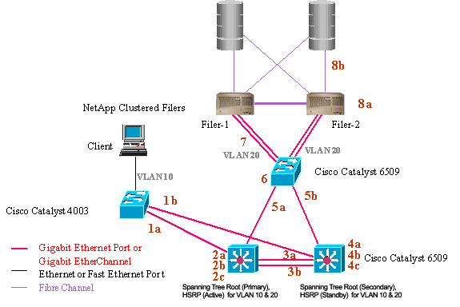
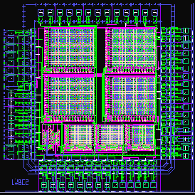
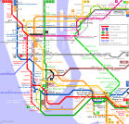
Applications of Minimal Spanning Trees
Communication networks
VLSI design
Transportation systems

Slide 26
Kruskal’s Algorithm for Minimum Spanning Trees
A greedy algorithm:
Initialize all vertices to unconnected
Heap = E /* priority queue on the edge costs */
while not(empty(Heap)) {
(u,v) = removeMin(Heap)
if u and v are not already connected
then add (u,v) to the minimum spanning tree
}
Sound familiar?
(Think maze generation.)
Notes:
Here’s how Kruskal’s works.
This should look very familiar. Remember our algorithm for maze creation?
Except that the edge order there was random, this is the same as that algorithm!

Slide 27
Kruskal’s Algorithm in Action
2
2
B
3
A
F
H
1
2
4
10
1
9
G
C
4
2
8
D
E
7
3
K
Notes:
Therefore, this example should look a lot like maze creation.
We test the cheapest edge first.
Since B and C are unconnected, we add the edge to the MST and union B and C.

Slide 28
Kruskal’s Algorithm in Action
2
2
B
3
A
F
H
1
2
4
10
1
9
G
C
4
2
8
D
E
7
3
K
Notes:
Therefore, this example should look a lot like maze creation.
We test the cheapest edge first.
Since B and C are unconnected, we add the edge to the MST and union B and C.

Slide 29
Kruskal’s Algorithm in Action (1/5)
2
2
B
3
A
F
H
1
2
4
10
1
9
G
C
4
2
8
D
E
7
3
K
Notes:
Therefore, this example should look a lot like maze creation.
We test the cheapest edge first.
Since B and C are unconnected, we add the edge to the MST and union B and C.

Slide 30
Kruskal’s Algorithm in Action
2
2
B
3
A
F
H
1
2
4
10
1
9
G
C
4
2
8
D
E
7
3
K
Notes:
I’ll do some uninteresting edges right away (all those edges until the 3 succeed).
Now, we test 3. Are F and H connected?
Yes, so we throw out the 3 edge.

Slide 31
Kruskal’s Algorithm in Action
2
2
B
3
A
F
H
1
2
4
10
1
9
G
C
4
2
8
D
E
7
3
K
Notes:
I’ll do some uninteresting edges right away (all those edges until the 3 succeed).
Now, we test 3. Are F and H connected?
Yes, so we throw out the 3 edge.

Slide 32
Kruskal’s Algorithm in Action
2
2
B
3
A
F
H
1
2
4
10
1
9
G
C
4
2
8
D
E
7
3
K
Notes:
What about A and D?
Connected: so throw out the 4 edge.

Slide 33
Kruskal’s Algorithm in Action
2
2
B
3
A
F
H
1
2
4
10
1
9
G
C
4
2
8
D
E
7
3
K
Notes:
Finally, G and E are unconnected, so we union them.
But, that connects the last unconnected vertices in the graph.
Therefore, we’re done.

Slide 34
Kruskal’s Algorithm in Action
2
2
B
3
A
F
H
1
2
4
10
1
9
G
C
4
2
8
D
E
7
3
K
Notes:
Here’s the minimum spanning tree.
Notice that just like with mazes:
the tree has no cycles
it touches all the vertices
there’s one unique path between
any two vertices.

Slide 35
Why Greediness Works
Proof by contradiction that Kruskal’s finds a minimum spanning tree:
Assume another spanning tree has lower cost than Kruskal’s.
Pick an edge e₁ = (u, v) in that tree that’s not in Kruskal’s.
Consider the point in Kruskal’s algorithm where u’s set and v’s set were about to be connected. Kruskal selected some edge to connect them: call it e₂ .
But, e₂ must have at most the same cost as e₁ (otherwise Kruskal would have selected it instead).
So, swap e₂ for e₁ (at worst keeping the cost the same)
Repeat until the tree is identical to Kruskal’s, where the cost is the same or lower than the original cost: contradiction!
Notes:
We already know this makes a spanning tree because our maze generation algorithm made a spanning tree.
But, does this find the minimum spanning tree?
Let’s assume it doesn’t. Then, there’s some other better spanning tree.
Let’s try and make that tree more like Kruskal’s tree.
(otherwise, Kruskal’s would have considered and chosen e₁ before ever reaching e₂)

Slide 36
Data Structures for Kruskal’s Algorithm
|E| times:
Once:
Initialize heap of edges…
Pick the lowest cost edge…
buildHeap
findMin/deleteMin
|E| times:
If u and v are not already connected…
…connect u and v.
union
runtime:
|E| + |E| log |E| + |E| ack(|E|,|V|)
Notes:
What data structures do we need for this?
Priority Queue and Disjoint Set Union/Find
What about initialization?
We need to put all the edges in a priority queue;
we can do that fast with a buildHeap call: O(|E|)
So, overall, the runtime is
O(|E|ack(|E|,|V|) + |E|log|E|)
Who knows what’s slower? Inverse ackermann’s or log?
LOG! How much slower? TONS!
One last little point: |E| is at most |V|², but log|V|² = 2 log |V|. So:
O(|E|log|V|)

Slide 37
Data Structures for Kruskal’s Algorithm
|E| times:
Once:
Initialize heap of edges…
Pick the lowest cost edge…
buildHeap
findMin/deleteMin
|E| times:
If u and v are not already connected…
…connect u and v.
union
runtime:
|E| + |E| log |E| + |E| ack(|E|,|V|) = O(|E|log|E|)
Notes:
What data structures do we need for this?
Priority Queue and Disjoint Set Union/Find
What about initialization?
We need to put all the edges in a priority queue;
we can do that fast with a buildHeap call: O(|E|)
So, overall, the runtime is
O(|E|ack(|E|,|V|) + |E|log|E|)
Who knows what’s slower? Inverse ackermann’s or log?
LOG! How much slower? TONS!
One last little point: |E| is at most |V|², but log|V|² = 2 log |V|. So:
O(|E|log|V|)

Slide 38
Prim’s Algorithm
In Kruskal’s algorithm we grow a spanning forest rather than a spanning tree
  Only at the end is it guaranteed to be connected, hence a spanning tree
In Prim’s algorithm we grow a spanning tree
T = the set of nodes currently forming the tree
Heap = the set of edges connecting some node in T with some node outside T
Prim’s algorithm: always add the cheapest edge in Heap to the spanning tree

Slide 39
Prim’s Algorithm
Pick any initial node u
T = {u} /* will be our tree; initially just u */
Heap = empty;
for all v in u.children() do
insert(Heap, (u,v));
While not(empty(Heap)) {
(u,v) = deleteMin(Heap);
T = T U {v};
for all w in v.children() do
if not(w in T) then insert(Heap, (v,w));
No union/find
ADT is needed here:
there is only one
“large” equivalence
class: T
Membership (w in T)
can be checked by
having a flag at each
node: w.isInT

Slide 40
All Pairs Shortest Path
Suppose you want to compute the length of the shortest paths between all pairs of vertices in a graph…
  Run Dijkstra’s algorithm (with priority queue) repeatedly, starting with each node in the graph:
  Complexity in terms of V when graph is dense:

Slide 41
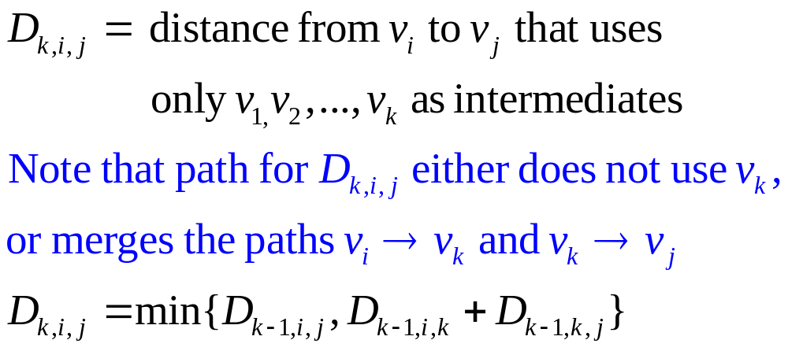
Dynamic Programming Approach
Notice that D_{k-1, i, k} = D_{k, i, k} and D_{k-1, k, j} = D_{k, k, j};
hence we can use a single matrix, D_{i, j} !

Slide 42
Floyd-Warshall Algorithm
// C – adjacency matrix representation of graph
// C[i][j] = weighted edge i->j or ∞ if none
// D – computed distances
for (i = 0; i < N; i++){
for (j = 0; j < N; j++)
D[i][j] = C[i][j];
D[i][i] = 0.0;
}
for (k = 0; k < N; k++)
for (i = 0; i < N; i++)
for (j = 0; j < N; j++)
if (D[i][k] + D[k][j] < D[i][j])
D[i][j] = D[i][k] + D[k][j];
Run time =
How could we compute the paths?

